Slide 1
?
1
too narrow
Joint action:
an action with two or more agents (Ludwig 2007)
Bodily movements ‘are all the actions there are’ (Davidson 1971, p. 59)
In supposedly paradigm cases of joint action, there are no bodily movements with more than one agent.
Therefore:
Supposedly paradigm cases are not joint actions.
tidying up the toys together
(Behne et al 2005)
cooperatively pulling handles in sequence to make a dog-puppet sing
(Brownell et al 2006)
bouncing a ball on a large trampoline together
(Tomasello & Carpenter 2007)
pretending to row a boat together
2
3
4

Slide 2
?
1
too narrow
Joint action:
an action with two or more agents (Ludwig 2007)
Bodily movements ‘are all the actions there are’ (Davidson 1971, p. 59)
In supposedly paradigm cases of joint action, there are no bodily movements with more than one agent.
Therefore:
Supposedly paradigm cases are not joint actions.
tidying up the toys together
(Behne et al 2005)
cooperatively pulling handles in sequence to make a dog-puppet sing
(Brownell et al 2006)
bouncing a ball on a large trampoline together
(Tomasello & Carpenter 2007)
pretending to row a boat together
2
3
4
Notes:
we could reject this ... but I want to pursue a different approach

Slide 3
1
too narrow
Joint action:
an action with two or more agents (Ludwig 2007)
Bodily movements ‘are all the actions there are’ (Davidson 1971, p. 59)
In supposedly paradigm cases of joint action, there are no bodily movements with more than one agent.
Therefore:
Supposedly paradigm cases are not joint actions.
tidying up the toys together
(Behne et al 2005)
cooperatively pulling handles in sequence to make a dog-puppet sing
(Brownell et al 2006)
bouncing a ball on a large trampoline together
(Tomasello & Carpenter 2007)
pretending to row a boat together
2
3
4
Notes:
we could reject this ... but I want to pursue a different approach

Slide 4
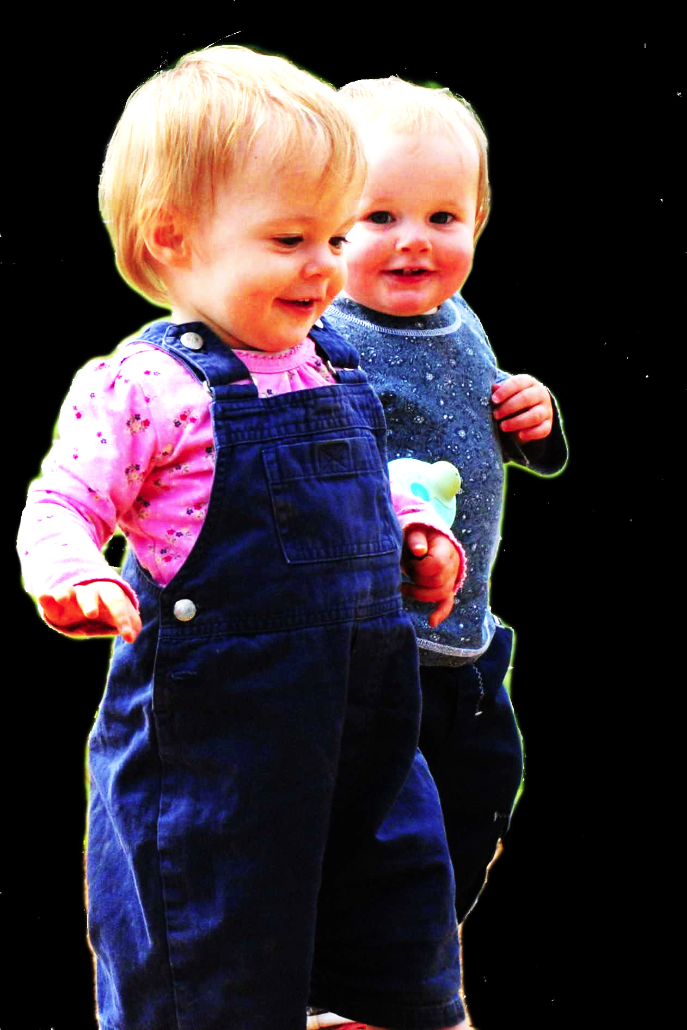
challenge
Show that a notion of joint action is already contained in a notion of action.
constraint
Any notion of joint action is
(a) central to a tangle of philosophical and scientific questions commonly taken to be questions about joint action, and
(b) such that an implicit conception of it is available through reflection on many or all of the cases commonly taken to be paradigmatic.

Slide 5
Goal-directed joint action: an event with two or more agents which, taken as a whole, is directed to a goal.
Goal-directed joint action
An event grounded by two or more agents’ actions where these actions have a collective goal.
G is a distributive goal
(a) it is an outcome to which each action is individually directed; and
(b) it is possible that: all actions succeed relative to this outcome.
G is a collective goal
(a) it is a distributive goal;
(b) the actions are coordinated; and
(c) coordination of this type would normally facilitate occurrences of outcomes of G’s type.

Slide 6
Goal-directed joint action: an event with two or more agents which, taken as a whole, is directed to a goal.
G is a distributive goal
(a) it is an outcome to which each action is individually directed; and
(b) it is possible that: all actions succeed relative to this outcome.
G is a collective goal
(a) it is a distributive goal;
(b) the actions are coordinated; and
(c) coordination of this type would normally facilitate occurrences of outcomes of G’s type.
Goal-directed joint action
An event grounded by two or more agents’ actions where these actions have a collective goal.

Slide 7
Goal-directed joint action: an event with two or more agents which, taken as a whole, is directed to a goal.
G is a distributive goal of some actions = it is an outcome to which each action is individually directed where it is possible that: all actions succeed relative to this outcome.
G is a collective goal
(a) it is a distributive goal;
(b) the agents’ activities are coordinated; and
(c) coordination of this type would normally facilitate occurrences of outcomes of this type.

Slide 8
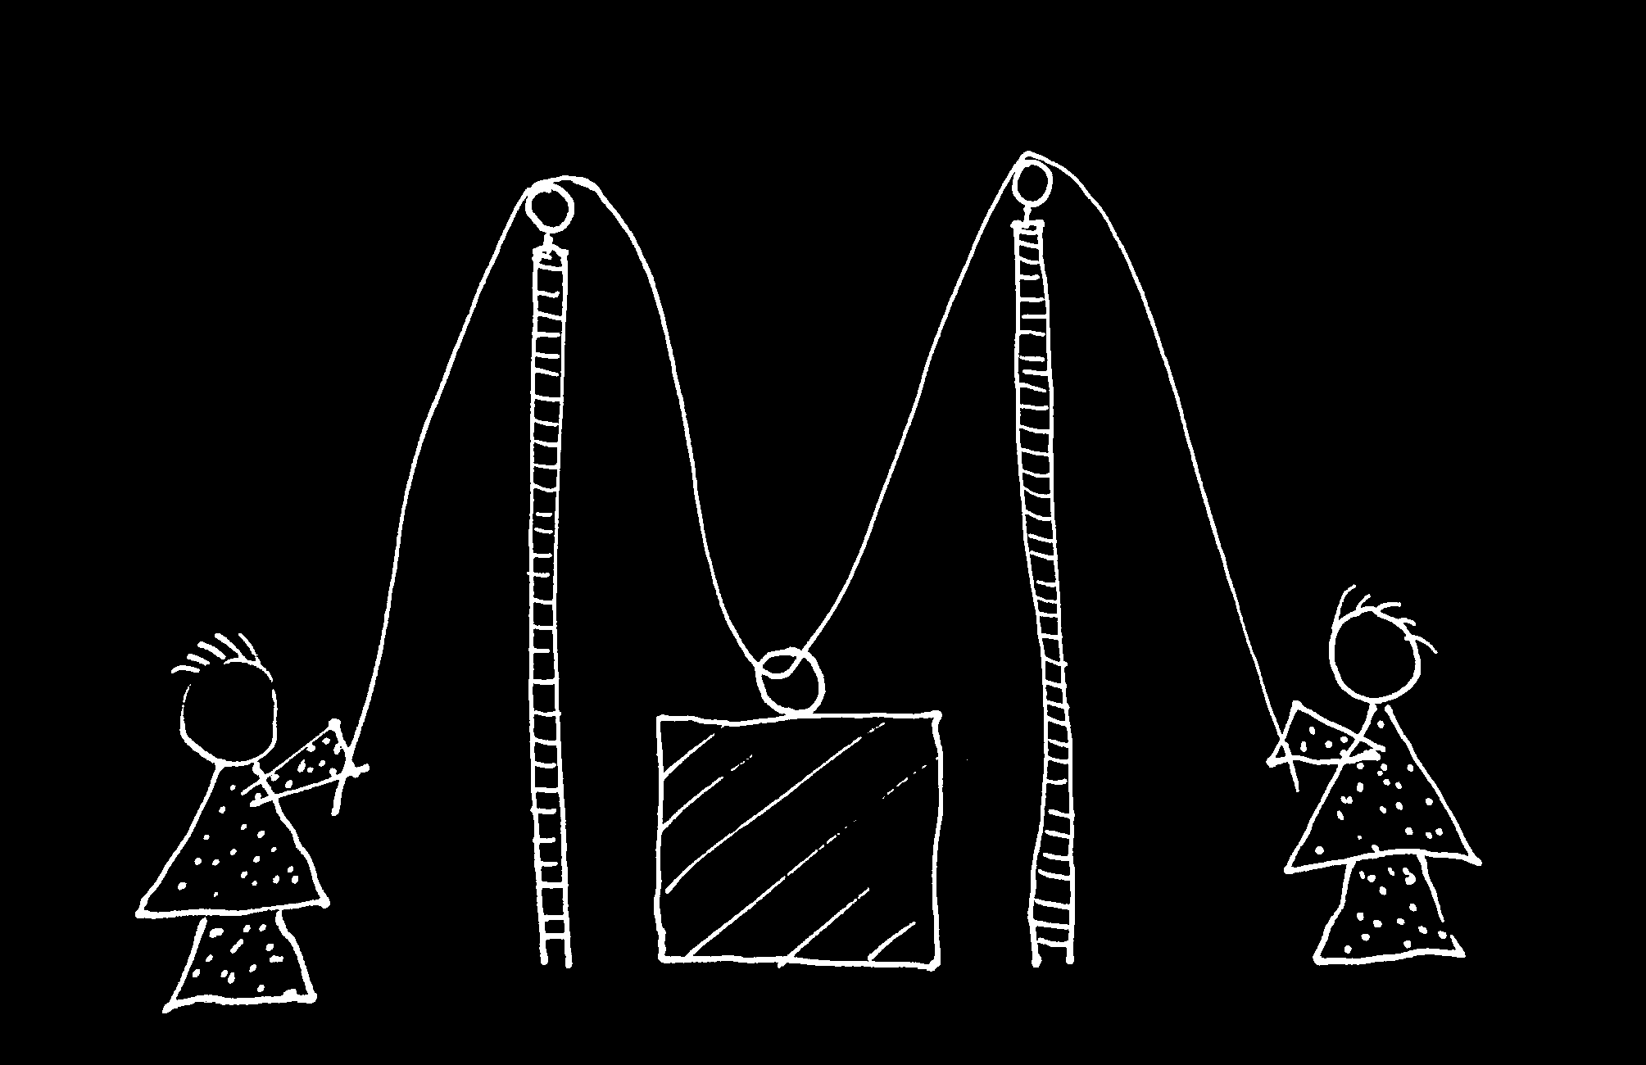

Slide 9
Goal-directed joint action: an event with two or more agents which, taken as a whole, is directed to a goal.
G is a distributive goal: it is an outcome to which each agent’s activities are individually directed and it is possible that: all agents succeed relative to this outcome.
G is a collective goal
(a) it is a distributive goal;
(b) the agents’ activities are coordinated; and
(c) coordination of this type would normally facilitate occurrences of outcomes of this type.

Slide 10
Goal-directed joint action: an event with two or more agents which, taken as a whole, is directed to a goal.
G is a distributive goal: it is an outcome to which each agent’s activities are individually directed and it is possible that: all agents succeed relative to this outcome.
G is a collective goal
(a) it is a distributive goal;
(b) the agents’ activities are coordinated; and
(c) coordination of this type would normally facilitate occurrences of outcomes of this type.

Slide 11
Joint action:
an action event with two or more agents (Ludwig 2007)
Goal-directed joint action:
An event grounded by two or more agents’ actions where these actions have a collective goal.

